Slide 1


CSS Box Model

Slide 2
Every element in web design is a rectangular box

Slide 3
CSS BASIC BOX MODEL
When laying out a document, the browser's rendering engine represents each element as a rectangular box according to the standard CSS basic box model. CSS determines the size, position, and properties (color, background, border size, etc.) of these boxes.

Slide 4
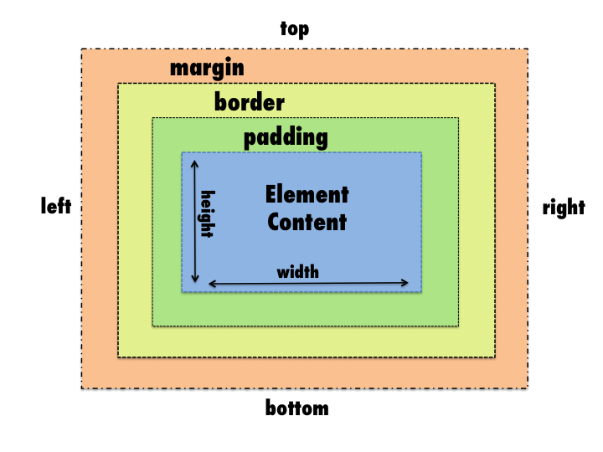
CSS BASIC BOX MODEL

Slide 5
DISPLAY
The display CSS property defines the display type of an element, which consists of the two basic qualities of how an element generates boxes — the outer display type defining how the box participates in flow layout , and the inner display type defining how the children of the box are laid out.
display: block;
display: block;

Slide 6
display: block;
HTML (Hypertext Markup Language) elements historically were categorized as either "block-level" elements or "inline" elements. By default, a block-level element occupies the entire space of its parent element (container), thereby creating a "block." This article helps to explain what this means.
Browsers typically display the block-level element with a newline both before and after the element. You can visualize them as a stack of boxes.

Slide 7
display: inline;
HTML (Hypertext Markup Language) elements historically were categorized as either "block-level" elements or "inline" elements. Inline elements are those which only occupy the space bounded by the tags defining the element, instead of breaking the flow of the content.

Slide 8
display: inline-block;
Gives us the ability to use vertical padding and margin on inline elements as well as adding width and height.

Slide 9
Width
The width CSS property sets an element's width. By default it sets the width of the content area, but if box-sizing is set to border-box, it sets the width of the border area.

Slide 10
Min/Max Width
min-width
The min-width CSS property sets the minimum width of an element. It prevents the used value of the width property from becoming smaller than the value specified for min-width.
max-width
The max-width CSS property sets the maximum width of an element. It prevents the used value of the width property from becoming larger than the value specified by max-width.

Slide 11
Height
The height CSS property specifies the height of an element. By default, the property defines the height of the content area. If box-sizing is set to border-box, however, it instead determines the height of the border area

Slide 12
Min/Max Height
min-height
The min-height CSS property sets the minimum height of an element. It prevents the used value of the height property from becoming smaller than the value specified for min-height.
max-height
The max-height CSS property sets the maximum height of an element. It prevents the used value of the height property from becoming larger than the value specified for max-height.

Slide 13
Default Width of Block elements
If you don't declare a width, and the box has static or relative positioning, the width will remain 100% in width and the padding and border will push inwards instead of outward. But if you explicitly set the width of the box to be 100%, the padding will push the box outward as normal.

Slide 14
Margin
The margin CSS property sets the margin area on all four sides of an element. It is a shorthand for margin-top, margin-right, margin-bottom, and margin-left.

Slide 15
Border
The border CSS property sets an element's border. It's a shorthand for border-width, border-style, and border-color.

Slide 16
Padding
The padding CSS property sets the padding area on all four sides of an element. It is a shorthand for padding-top, padding-right, padding-bottom, and padding-left.

Slide 17
Box Sizing
The box-sizing CSS property defines how the user agent should calculate the total width and height of an element.

Slide 18
UNIVERSAL BOX SIZING WITH INHERITANCE
html {
box-sizing: border-box;
}
*, *:before, *:after {
box-sizing: inherit;
}

Slide 19
Resources
https://developer.mozilla.org/en-US/docs/Web/CSS/display
https://developer.mozilla.org/en-US/docs/Web/CSS/CSS_Box_Model/Introduction_to_the_CSS_box_model
https://developer.mozilla.org/en-US/docs/Web/CSS/box-sizing
https://developer.mozilla.org/en-US/docs/Web/CSS/CSS_Box_Model/Mastering_margin_collapsing
https://css-tricks.com/the-css-box-model/
https://css-tricks.com/box-sizing/
https://developer.mozilla.org/en-US/docs/Web/CSS/float
https://developer.mozilla.org/en-US/docs/Web/CSS/clear

